Slide 1

Digital Transformation

Slide 2



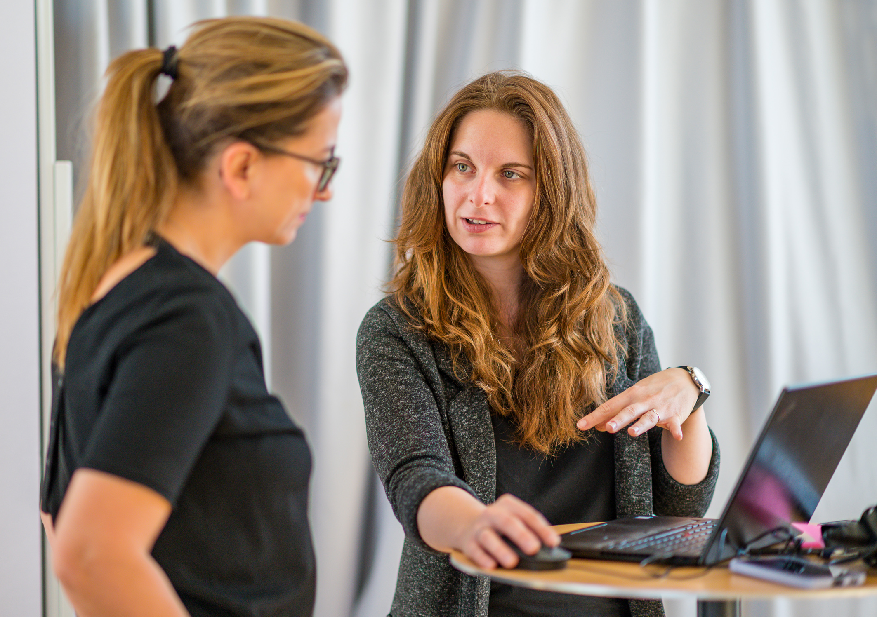
Digital Transformation │ Day 1
01 / Welcome, Goals, Agenda
02 / Check-in questions
03 / VUCA & Digitisation
04 / Future Oriented Organisations: Responsive Organisations, Exponential Organisations
05 / What is Digital Transformation
Break
06 / Is my company ready for Digital Transformation?
Lunch-Break
07 / Case Study Work: a successful digital transformation made by a global company
Break
08 / Case Study Debrief
09 / Main Learnings from the Case Study
10 / Feedback & Closing
The Why behind Digital Transformation
And what is actually Digital Transformation?
Participants: 10 - 12 Persons
Middle Management and Teams

Slide 3
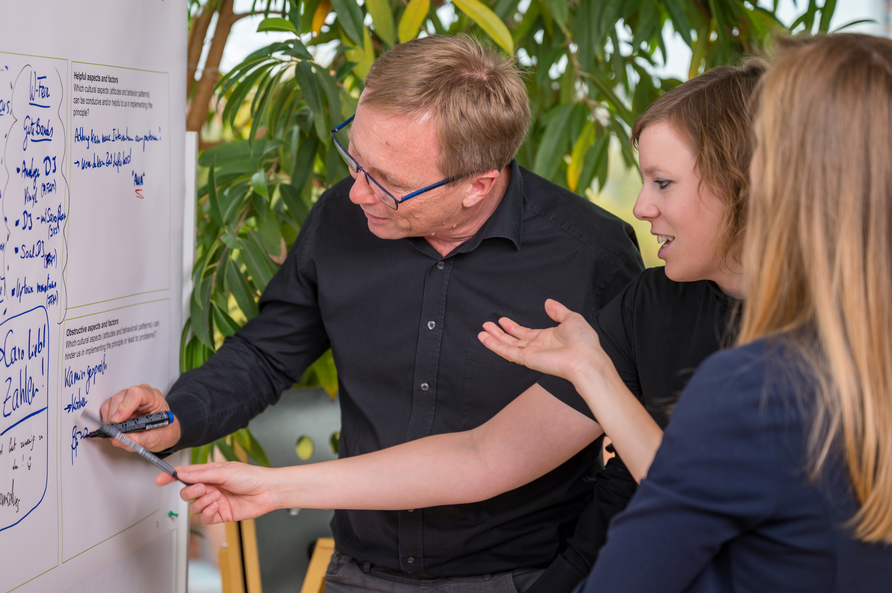
Digital Transformation │ Day 2
01 / Review of 1st day
02 / A structured approach to Digital Transformation
03 / 3 x 3 model for Digitalisation
Break
04 / New Ways of Working in the context of Digital Transformation
05 / Leadership Roles in Digital Transformation
06 / Stanford Model for Digital Transformation
Lunch-Break
07 / Actions to foster Digital Transformation
Break
08 / Conclusions and main learnings
09 / Feedback & Closing
ICG & Stanford Models for Digitalisation
Leading the process & Specific Actions
Participants: 10 - 12 Persons
Middle Management and Teams

Slide 4

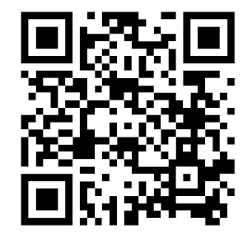
About ICG
A short glimpse in our professional life, in our beliefs and values
https://youtu.be/R9vM8tOvrYI

Slide 5
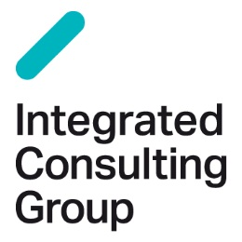
About ICG
We work with a special consulting approach that combines change management, organizational design and business aspects in a “state-of-the-art” way.
We support companies of all sectors – corporations, medium-sized companies, public-sector companies – and know each of the specific features.
We support companies of all sectors – corporations, medium-sized companies, public-sector companies – and know each of the specific features.
Supporting transformation processes means for us also the professional design of change communication including large group events as well as learning formats.
Our team exclusively consists of very experienced change management professionals who are fully committed to the cause and create development based on partnership.
Our ICG team consists of 140 consultants from 12 countries and therefore has know-how and experience from different cultures.
We are “hands-on” consultants, impact is more important to us than concepts.
We are “hands-on” consultants, impact is more important to us than concepts.

