Slide 1

Design Thinking

Slide 2


DESIGN THINKING
The primary purpose of this workshop is to learn Design Thinking by experimenting it during a practical experience around a specific subject.
Design thinking fundamentally shifts an organization’s mindset to be more human-centric, innovative, and collaborative
People benefit: they develop empathy and user-centricity, creativity & innovation, collaboration and teamwork. They learn how to operate with an iterative and experimental mindset and how to integrate user feedback and validation.
Organisation benefit: Learning design thinking empowers individuals and organisations to take ownership of challenges and believe in their ability to create positive change. It builds confidence in problem-solving, encourages a proactive approach, and nurtures a mindset of continuous learning and growth
The Program includes Design Thinking methodology, experience a simplified Design Thinking process on a specific subject and experiments with several tools on each Design Thinking process step. 5 principles on how to organise Design Thinking projects are presented in the end.
The program can be configured depending on the group or specific requirements.
Participants: max. 15 Persons (classroom or online)
Cost: starting from 1.400 900 EUR

Slide 3


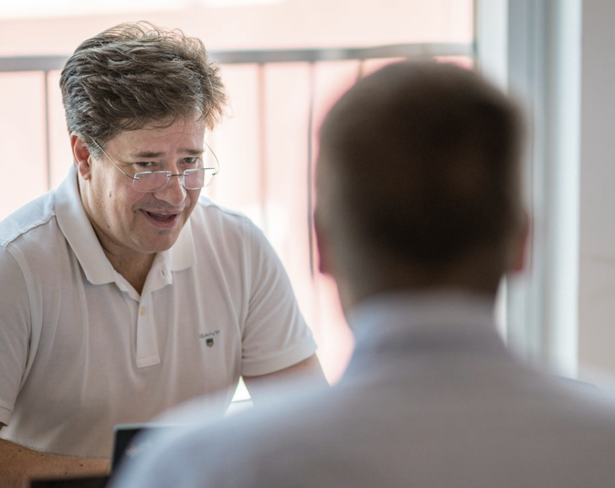




People
Our
This is us −
in 120 seconds

Slide 4





clients
Our
an excerpt
Production Industry
ABB | ACO | Ahlstrom | AkzoNobel | Alcatel Lucent | Andritz | AVL | BASF |
Bayer Material Science | BMW | Boehringer | Bosch | Bridgestone | Carlsberg | Coca-Cola | Constantia | Continental | Dacia Renault | Daiichi-Sankyo | DS Smith
| DuPont | Egis | Ericsson | Evonik | Festo | Fortum | Foxconn | Fresenius | GE Healthcare | General Electric | GlaxoSmithKline | Hauni | Head | Heineken | Heraeus | Hoffmann La-Roche | Klarwin | Knorr-Bremse | Kone | KraussMaffei | Lenzing | Magna | Mercedes Benz | Metso | Mitsubishi | Momentive | Neste Oil | Nokia | Nokian Tyres | OMV Petrom | Orion | Panasonic | Pepsi | Philips | Richter | Sandvik | Sanofi-Aventis | Scandia | Shell | Siemens | SMS Siemag | Stora Enso | STRABAG | Teleste | TMD Friction | Tridonic | Unilever | UPM | Vacon | Valio |
Velux | Versapak | Voith | Wacker Neuson | Wärtsilä | Wienerberger | ZF | Zwack
State-Owned Companies, Health Organizations
AKH Vienna General Hospital | Austrian Federal Computing Centre | Austrian
Federal Forests | Austrian Federal Theater | Austrian National Bank | Austrian
Railways | Barmherzige Brüder | Energy Styria | Feibra | Finnish Institute of
Occupational Health | Finnish Railroads | Forest Ministry | GIZ | Holding Graz | Hospital Köln | ITSV | Linz AG | Maasstad Ziekenhuis | Magyar Posta | Medical
Delta | NATO | Österreich Werbung | Posti Finland | ProRail | Social Security Institution | SUVA Swiss Insurance | Theater of Graz | Veikkaus
Retail and Service Industry
A1 Telekom Austria | Acredia Insurance | Adobe | Airport Graz/Vienna | Allianz | Arvato Bertelsmann | .A.S.A. | Austrian Airlines | Austrian Post | AVIS | Budget
Group BSC | BKS Bank | Budapest Bank/GE | Conwert | CSOB | D.A.S. Insurance | dm drogerie markt | Enel | E.ON | Erste Bank | Erste Group Immorent | Finnair | Finnish Fair Center | Finnish Railroads | German Railway | GSK Stockmann | Helsinki OP Bank | HOPI | ING | Innogy | ISS | Joanneum Research | Kleine Zeitung | Klöckner | LOGICDATA | Metro Group | MOTIONDATA | Neuroth | NORDEA | OeEB | OeKB | One / 3 | Orange | OTP | Rabobank | Raiffeisen International | Randstad | REWE | Saubermacher | Sodexo | Styrian Savings Bank | Suntours | Trans-Sped | T-Systems | Vodafone | Zurich Group
Public Administration, Universities, NPO & NGO
Aalto University | Austrian Federal Ministries: Agriculture, Culture, Education,
Environment, Finances, Health, Internal Affairs, Social Security | Caritas | Cities: Alkmaar, Graz, Helsinki, Linz, Rotterdam, Vienna | Euma | European Commission |
European Institutions | EUSA | Graz University of Technology | Kemi-Tornio
University | Leiden University | Provincial-Governments: Berlin, Hamburg, Lower Austria, Salzburg, Styria, Upper Austria, Vorarlberg | Romanian Federal Ministry
of Finance | University of Music Vienna | University of Veterinary Medicine Vienna | Utrecht University | Vienna University of Economics and Business
integratedconsulting.ro

Slide 5

Make an
Impact.
integratedconsulting.ro

